Slide 1
Seattle Power Outage
Team 4
YuanYuan Shi, Yanbo Qi, Ryan Kastilani, Jerry Chen

Slide 2
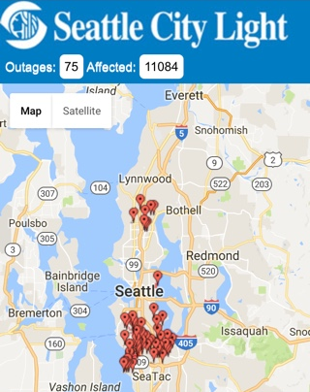
Motivation
We LOVE Seattle ❤️
Pain points
Power outage happens almost everyday in Seattle from couples to hundreds.
Seattle City Light
Doesn’t know how many specialists should be hired daily. The cost is high for emergency repair, or customers need to wait longer time because the short of personal.
Doesn’t know where is the possible locations and what types of equipment failure could happen. Underground transformer failure and insulator failure require different teams to repair.
Solutions
Use Machine Learning…
Predict the number of power outage daily. (e.g. 70% chance of having 6-10 outages)
Predict the failure type. (e.g. equipment-caused or tree/animal-caused failure)
Visualize…
Use dashboard and heat map to help users to understand the outage history
02/06/2017 9:41AM

Slide 3
Review
New York City
(Columbia, MIT)
Machine Learning for the New York City Power Grid (Rudin et. al., 2012)
Goal: Predict the risk of failures for components and systems by rank
Input: Outage History + Transformer telemetry + System Load + Temp. (2002-2009)
ML: Ranking (k-fold cross validation) + ROC plots / region, citywide
Kansas City
(Kansas State University)
Estimation of Overhead Distribution System Outages Caused by Wind and Lightning Using an Artificial Neural Network (Kankanala, 2012)
Goal: Overhead distribution system; Distribution reliability; Weather & animal-related outages
Input: weather (wind, light strokes) (2005 - 2009)
ML: 3-layer neural network
Seattle City
(UW)
Power Outages in Seattle: Where, Why and How long? (CSE546 Course project)
Goal: Predict outage duration
Input: Outage History (Type, Location, maintenance time, affected customer) + Weather (Wind, Humidity, Temp.) (2000 - 2016)
ML: LASSO model / 2-layer neural network

Slide 4

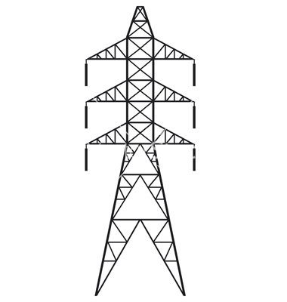

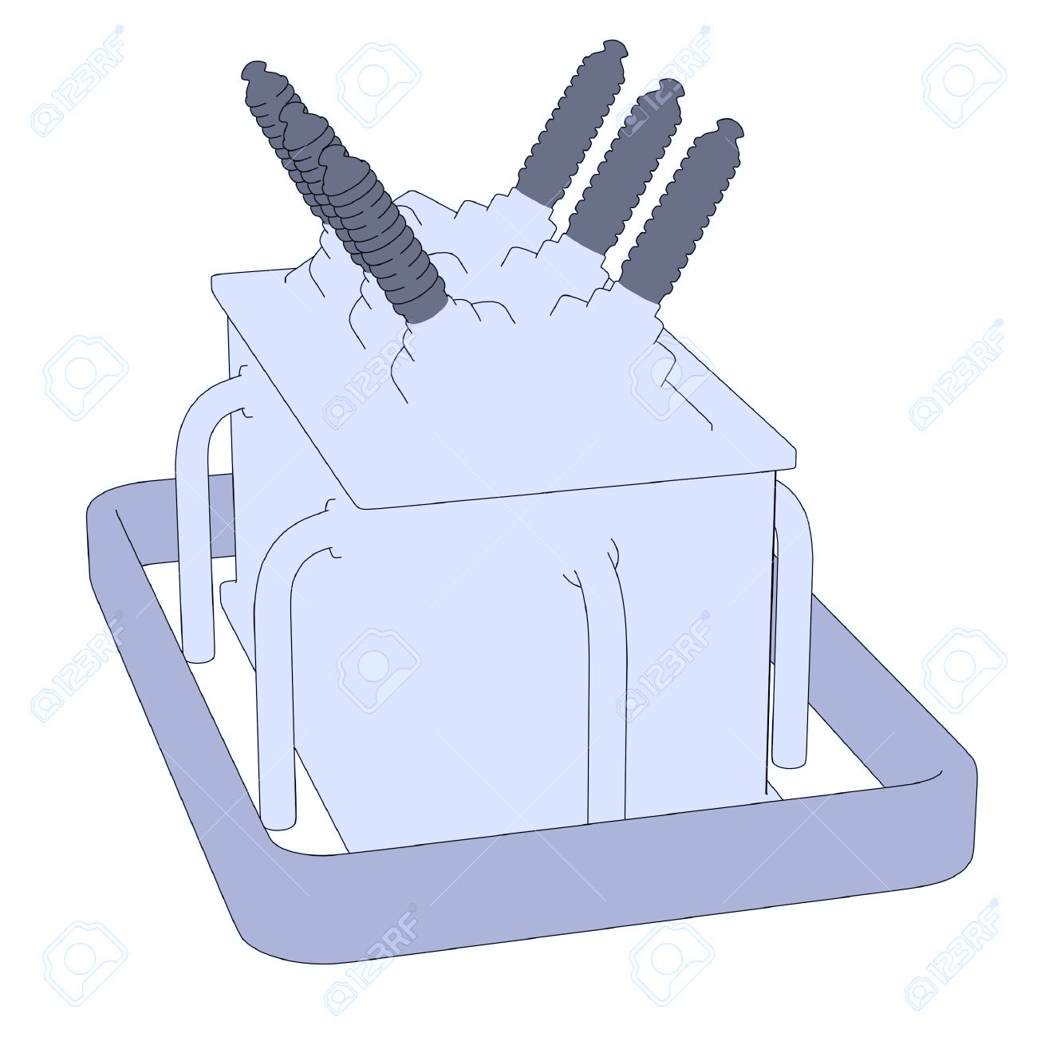
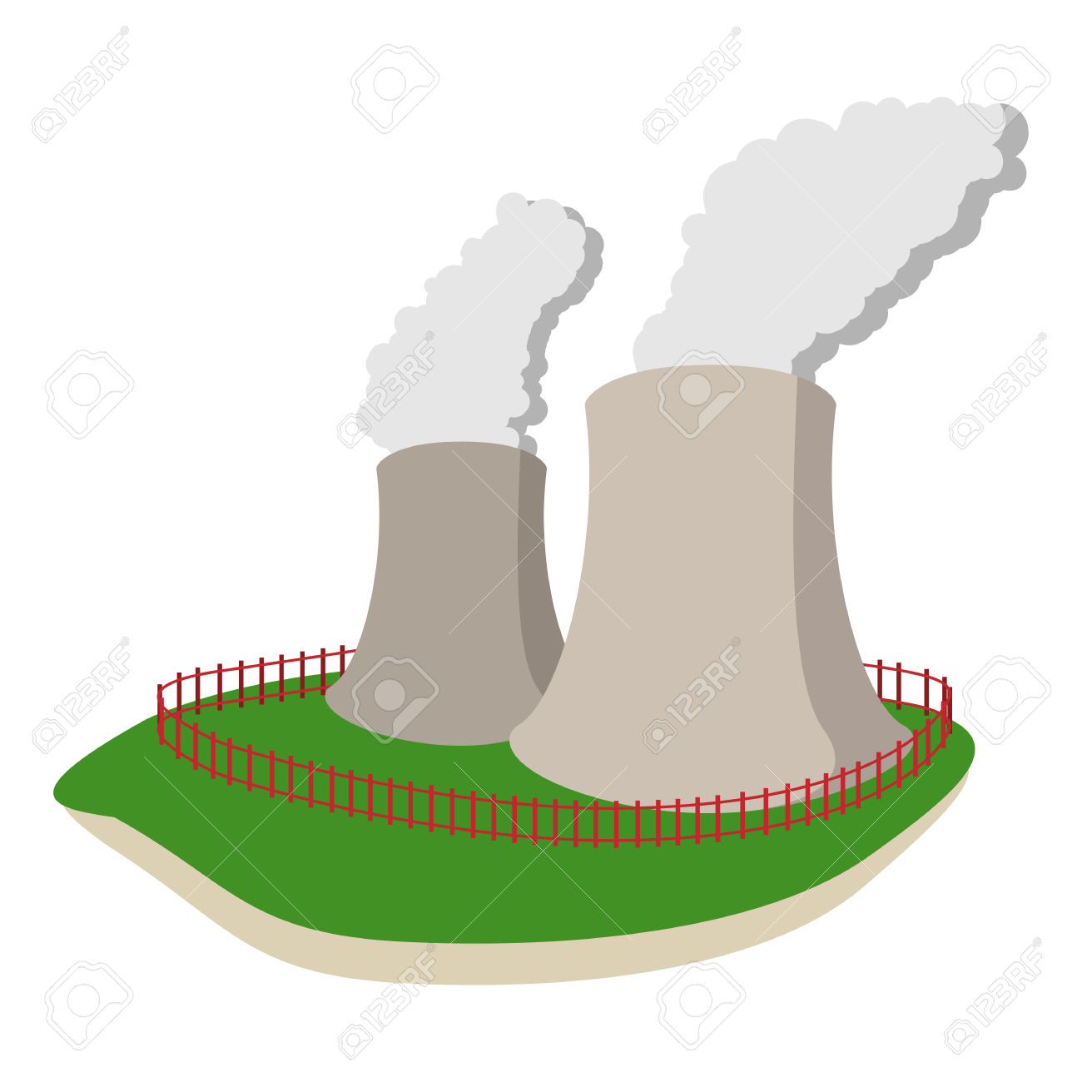

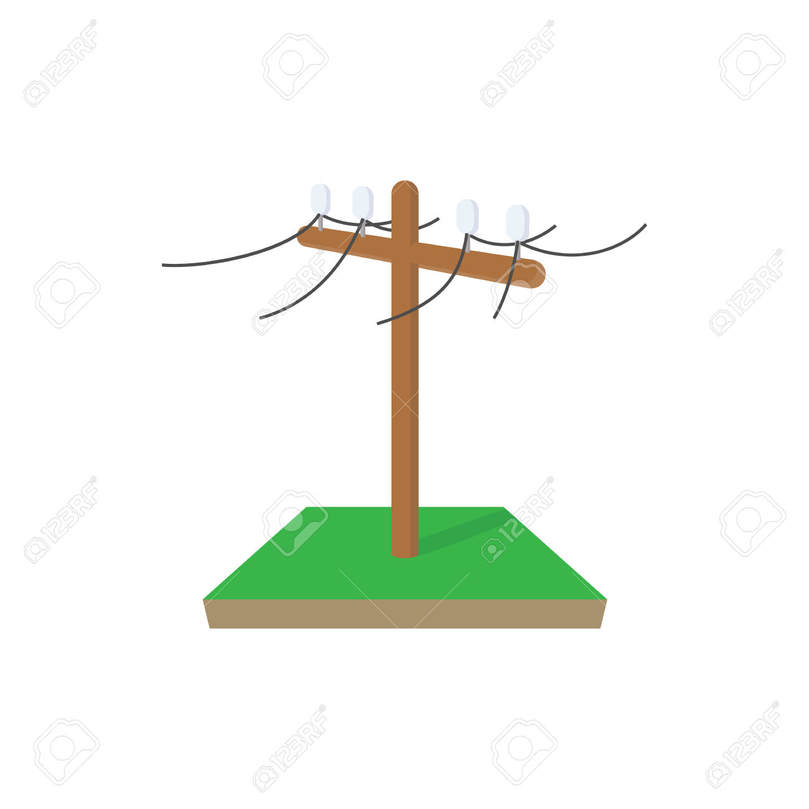
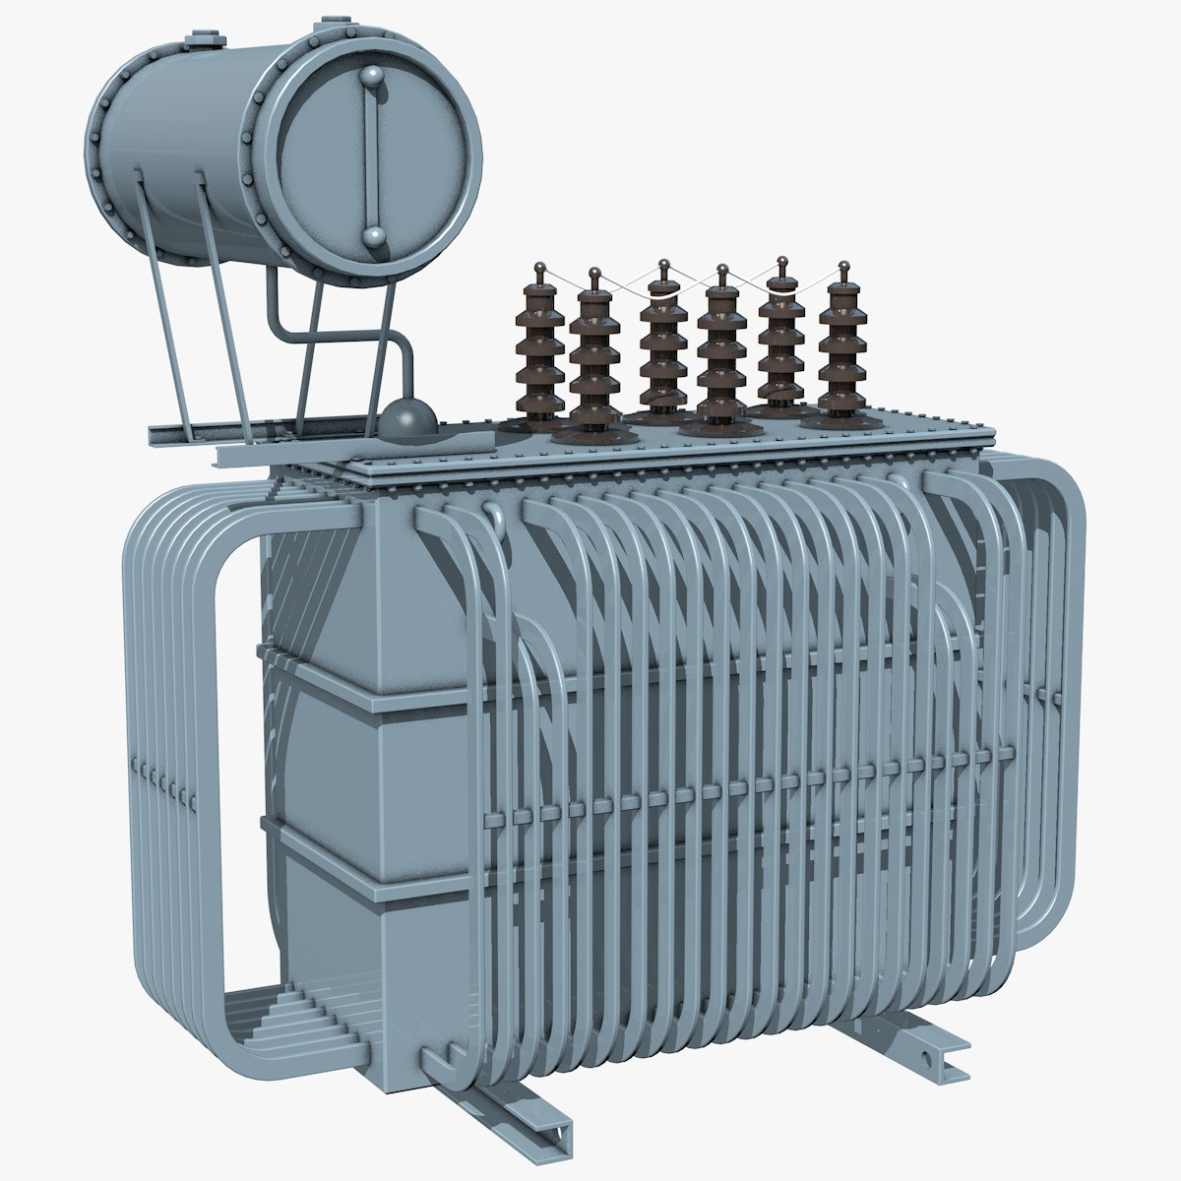
POWER Grid
Power generation
High-voltage
Transmission
Substation
(step-down transformer)
Feeders
(Primary network)
27,000V
Transformer
(Secondary network)
120V
Image source: Google Image

Slide 5
Process
Outage History
Weather History
Time Between Failure
Failure Type
Temp.
Humidity
Feed # (Location)
# of outages
Avg./Max.
Wind Speed
Sunrise/set
Data Processing
Cleaning
Pattern matching
Statistics
Labels outage types
Problem Reformulation
Machine Learning (use 2000-2014 data)
Linear
Linear regression + regularization
Logistic Regression
Non-Linear
K-Nearest Neighbors (KNN)
Support Vector Machines (SVM)
Tree-based Methods
Neural Network/Deep Neural Network
Evaluation (use 2015-2016 data)

Slide 6
Use Case
Decide the # of on-call specialists
Enter
Temp.
Get Prediction
# of outages
Hire certain types of specialists
Avg./Max.
Wind Speed
Outage Feed
Humidity
Failure Type
Sunrise/set
Have proactive maintenance plan

Slide 7
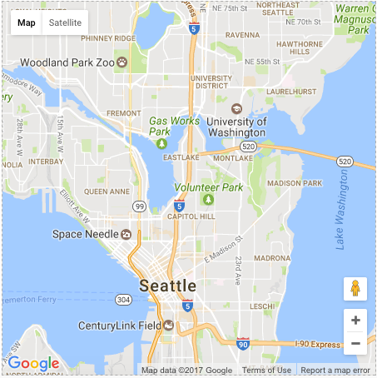

Visualization
Current Time: 02/13/2017 14:20
Tomorrow
Total
Chance
Equipment
Tree/Animal
Controlled
0 - 10
60 %
4
2
Seattle Power Outage
Ver. 0.1
Start
End
2741
08/07/2007
08/07/2007
2007
Year
2659
2000
2017
Aug
Month
Jan
Dec
7
Day
2647
1
31
Feed | Type
2741 | UG riser fuse
2647 | Insulator
2752 | Insulator
2659 | UG Transformer
2752
7

